Slide 1
Bayesian Statistics
how our prior knowledge affects our posterior knowledge

Slide 2
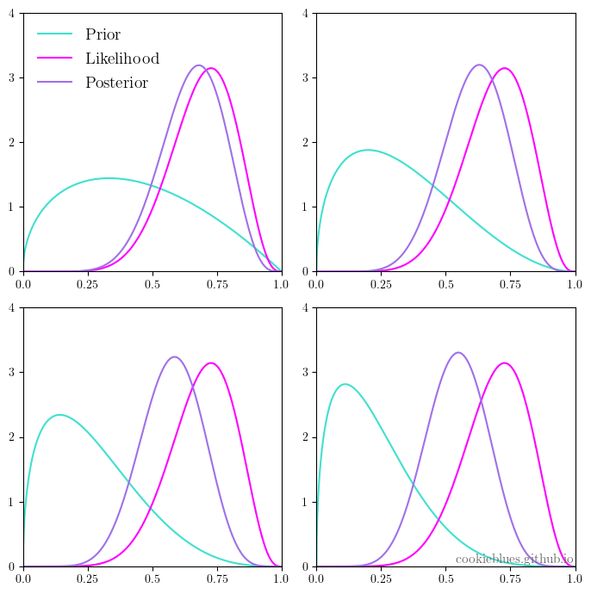
our prior knowledge affects our posterior knowledge
“Bayesian” first appeared around the 1950s by R. A. Fisher
the concept was properly formalized long before by P. S. Laplace in the 18th century, but known as “inverse probability”

Slide 3
The philosophical difference between the frequentist and Bayesian interpretation of probability is their definitions of probability: the frequentist (or classical) definition of probability is based on frequencies of events, whereas the Bayesian definition of probability is based on our knowledge of events. In the context of data science, we can interpret this difference as: what the data says versus what we know from the data.

Slide 4
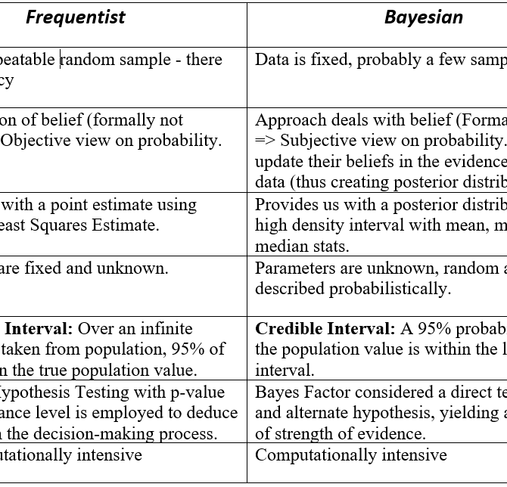
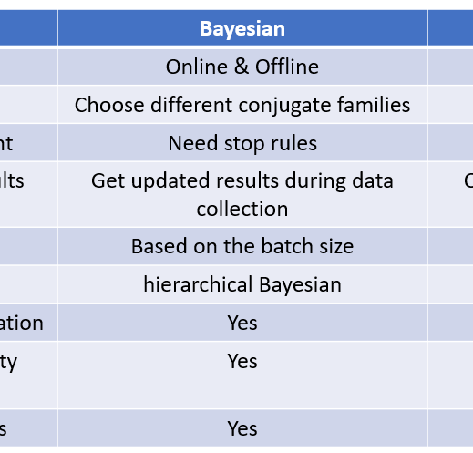
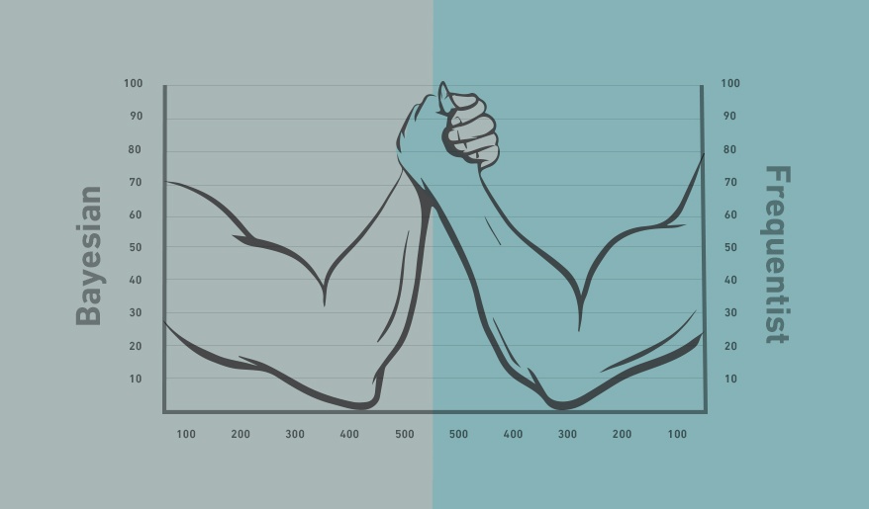
Analogy
I have misplaced my phone somewhere in the home. I can use the phone locator on the base of the instrument to locate the phone and when I press the phone locator the phone starts beeping.
Problem: Which area of my home should I search?

Slide 5
Bayesian Reasoning
Frequentist Reasoning
I can hear the phone beeping. I also have a mental model which helps me identify the area from which the sound is coming. Therefore, upon hearing the beep, I infer the area of my home I must search to locate the phone.
I can hear the phone beeping. Now, apart from a mental model which helps me identify the area from which the sound is coming from, I also know the locations where I have misplaced the phone in the past. So, I combine my inferences using the beeps and my prior information about the locations I have misplaced the phone in the past to identify an area I must search to locate the phone.

Slide 6
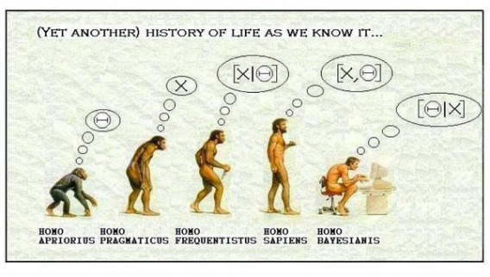
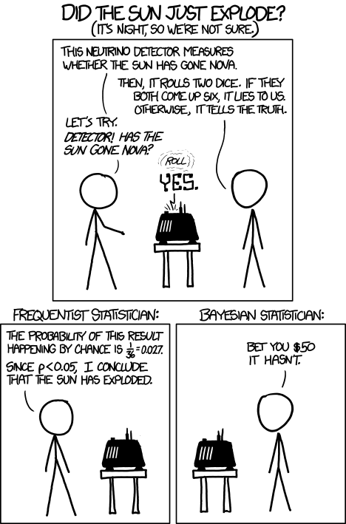
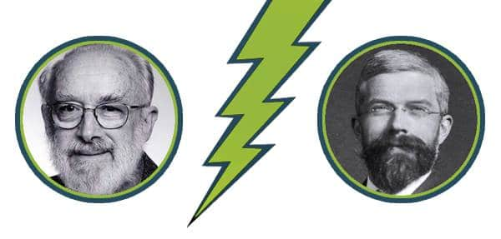
Lindley
vs
Fisher

Slide 7

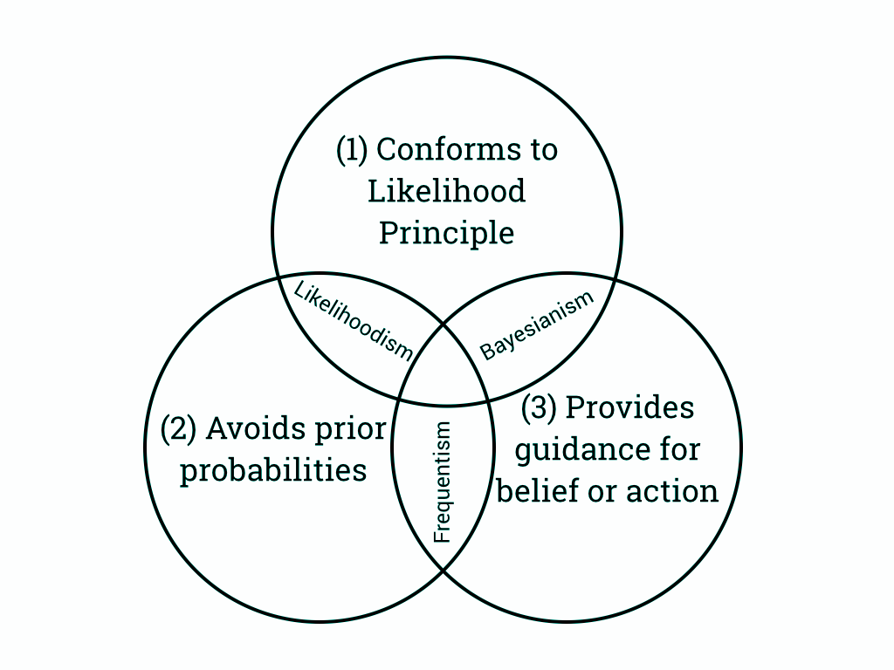

Bayes’ theorem
Let’s say we have two sets of outcomes A and B (also called events). We denote the probabilities of each event P(A) and P(B) respectively. The probability of both events is denoted with the joint probability P(A, B), and we can expand this with conditional probabilities
The evidence (the denominator above) ensures that the posterior distribution on the left-hand side is a valid probability density and is called the normalizing constant. Since it’s just a normalizing constant though

Slide 8
Bayesian Statistical Inference
The goal is to draw inferences about an unknown variable X by observing a related random variable Y. The unknown variable is modeled as a random variable X, with prior distribution
f_{X}(x),if X is continuous,P_{X}(x),if X is discrete.
After observing the value of the random variable Y, we find the posterior distribution of X. This is the conditional PDF (or PMF) of X given Y=y,
f_{X|Y}(x|y) or P_{X|Y}(x|y).
The posterior distribution is usually found using Bayes' formula. Using the posterior distribution, we can then find point or interval estimates of X.

Slide 9
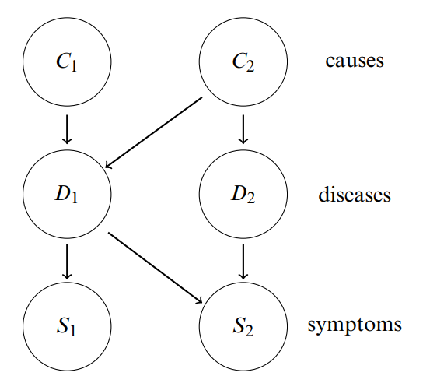
Bayesian or Belief Networks
Foundations of Data Science

Slide 10
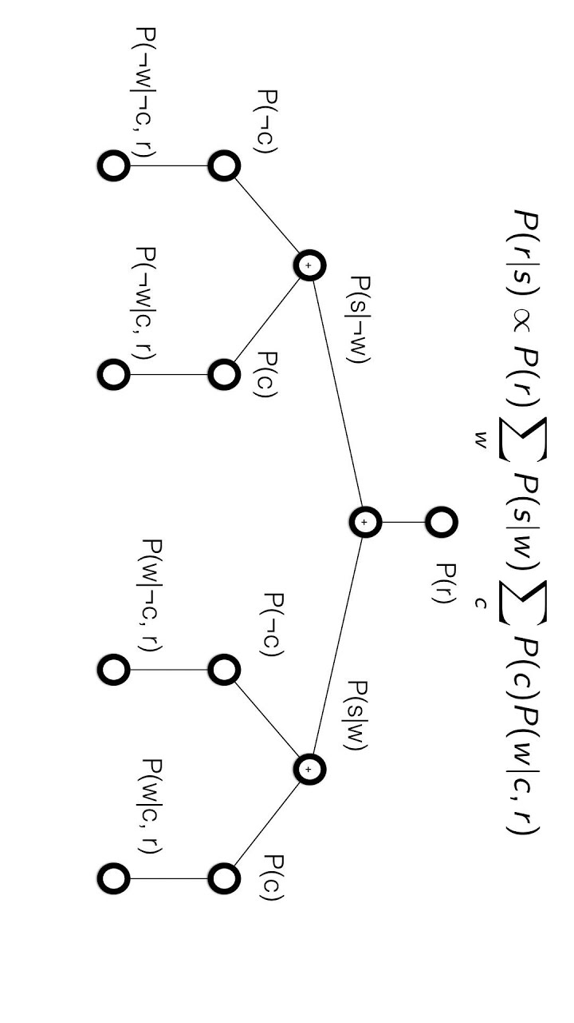
A Bayesian network can be described briefly as an
acyclic directed graph (DAG) which defines a factorization of a joint probability
distribution over the variables that are represented by the nodes of the DAG, where
the factorization is given by the directed links of the DAG.

Slide 11
Bayes Server

Slide 12
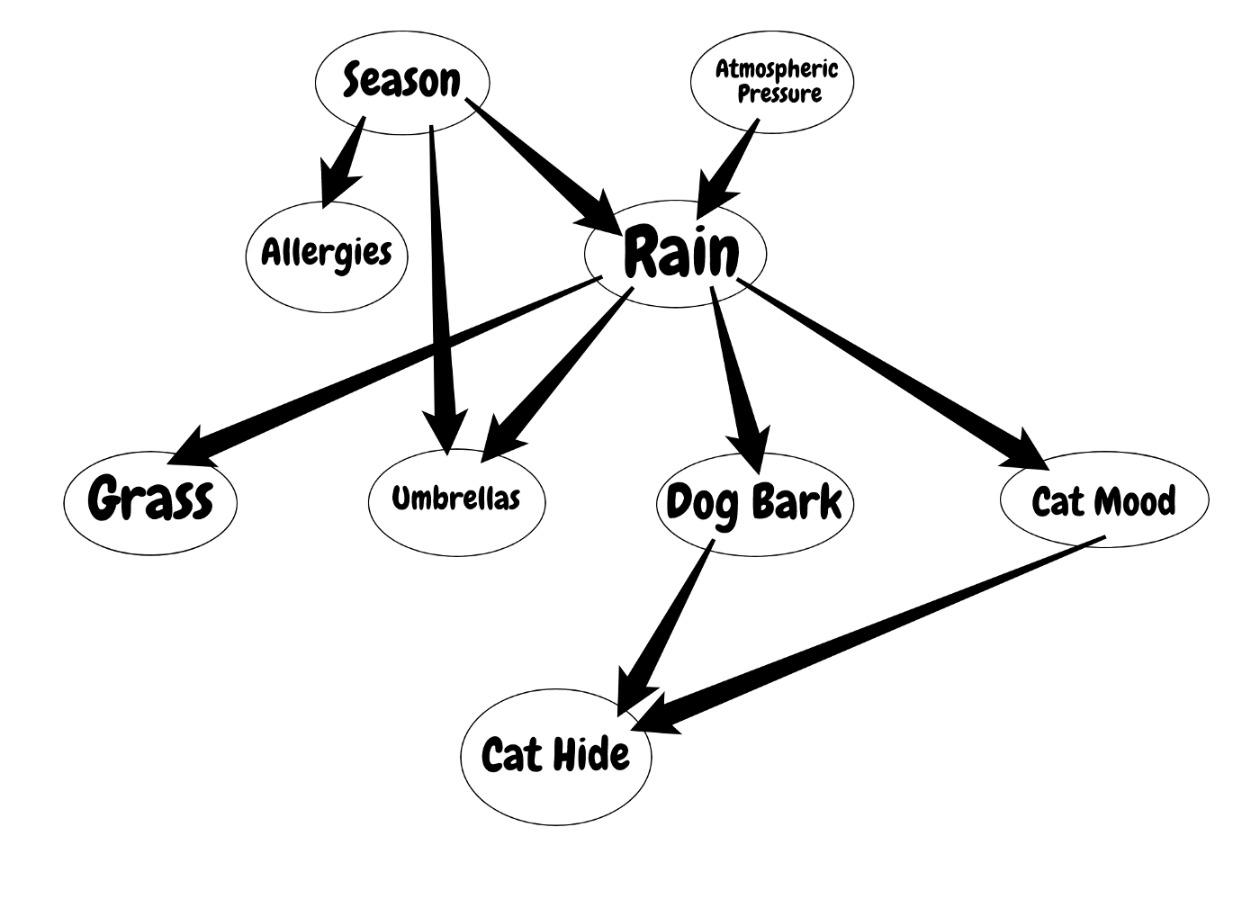

Slide 13
Bayesian Networks
and Influence Diagrams:
A Guide to Construction
and Analysis
Examples

Slide 14
references
An Introduction to Bayesian Thinking - https://statswithr.github.io/book/
Bayesian Inference - https://seeing-theory.brown.edu/bayesian-inference/
What Is Bayesian Inference? - https://towardsdatascience.com/what-is-bayesian-inference-4eda9f9e20a6
Frequentist and Bayesian Approaches in Statistics - https://www.probabilisticworld.com/frequentist-bayesian-approaches-inferential-statistics/
An Introduction to Likelihoodist, Bayesian, and Frequentist Methods - https://gandenberger.org/2014/07/28/intro-to-statistical-methods-2/
Wikipedia - https://en.wikipedia.org/wiki/Bayesian_inference
9.1.0 Bayesian Inference - https://www.probabilitycourse.com/chapter9/9_1_0_bayesian_inference.php
Bayesian inference by Marco Taboga, PhD - https://www.statlect.com/fundamentals-of-statistics/Bayesian-inference

